Slide 1
Case Study C.1 – Sep 20
Agenda
Case Study C.1 Emoji Equity
Begin / Complete
Upcoming
Past Due: Mod B.1 Python Introduction

Slide 2
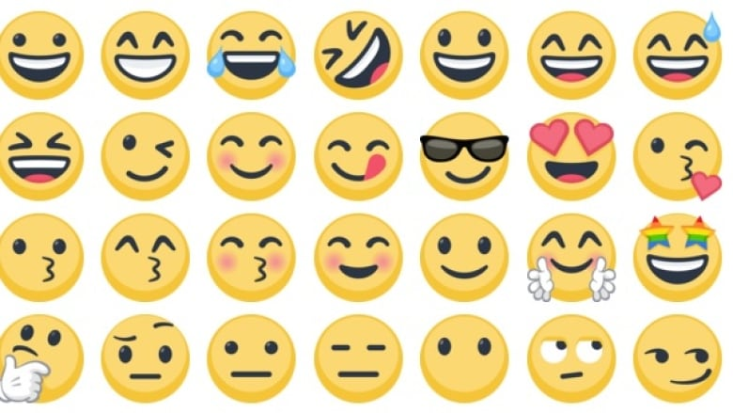

Slide 3
